Slide 1


Virtual Reality Gaze Exposure Treatment Reduces State Anxiety During Public Speaking
An RCT
Fabian D Mueller ^{a,e,1}, Bernhard Fehlman ^{a,e,1}, Nan Wang ^{a,e}, Merle K Ibach ^{a,e}, Thomas Schlitt ^{a,e}, Dorothée Bentz ^{a,e},
Anja Zimmer ^{a,e}, Andreas Papassotiropoulos ^{b,c,d,e}, and Dominique JF de Quervain ^{a,d,e}
ª Division of Cognitive Neuroscience | ^{b} Division of Molecular Neuroscience, Department of Medicine, University of Basel, Switzerland | ^{c} Life Sciences Training Facility, Department Biozentrum, University of Basel, Switzerland | ^{d} University Psychiatric Clinics, University of Basel, Switzerland |
^{e} Transfaculty Research Platform, University of Basel, Switzerland , ¹ These authors contributed equally to this work.

Slide 2
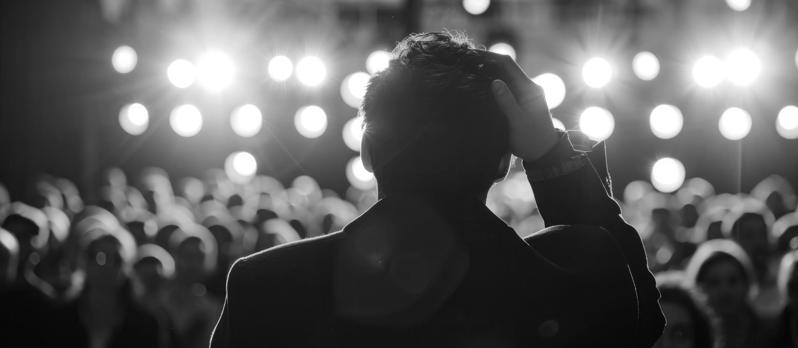
Background
Image: Adobe stock
Public speaking anxiety (PSA) is a prevalent social anxiety, affecting up to 30% of the population.¹
PSA is characterized by fear of being evaluated by others and the avoidance of eye contact.²
Gaze avoidance may be driven by a desire to reduce state anxiety but maintain anxiety in the long term.³
We developed a stand-alone gaze exposure treatment in virtual reality (VR) to test the potential of reducing gaze avoidance to reduce anxiety.

Slide 3
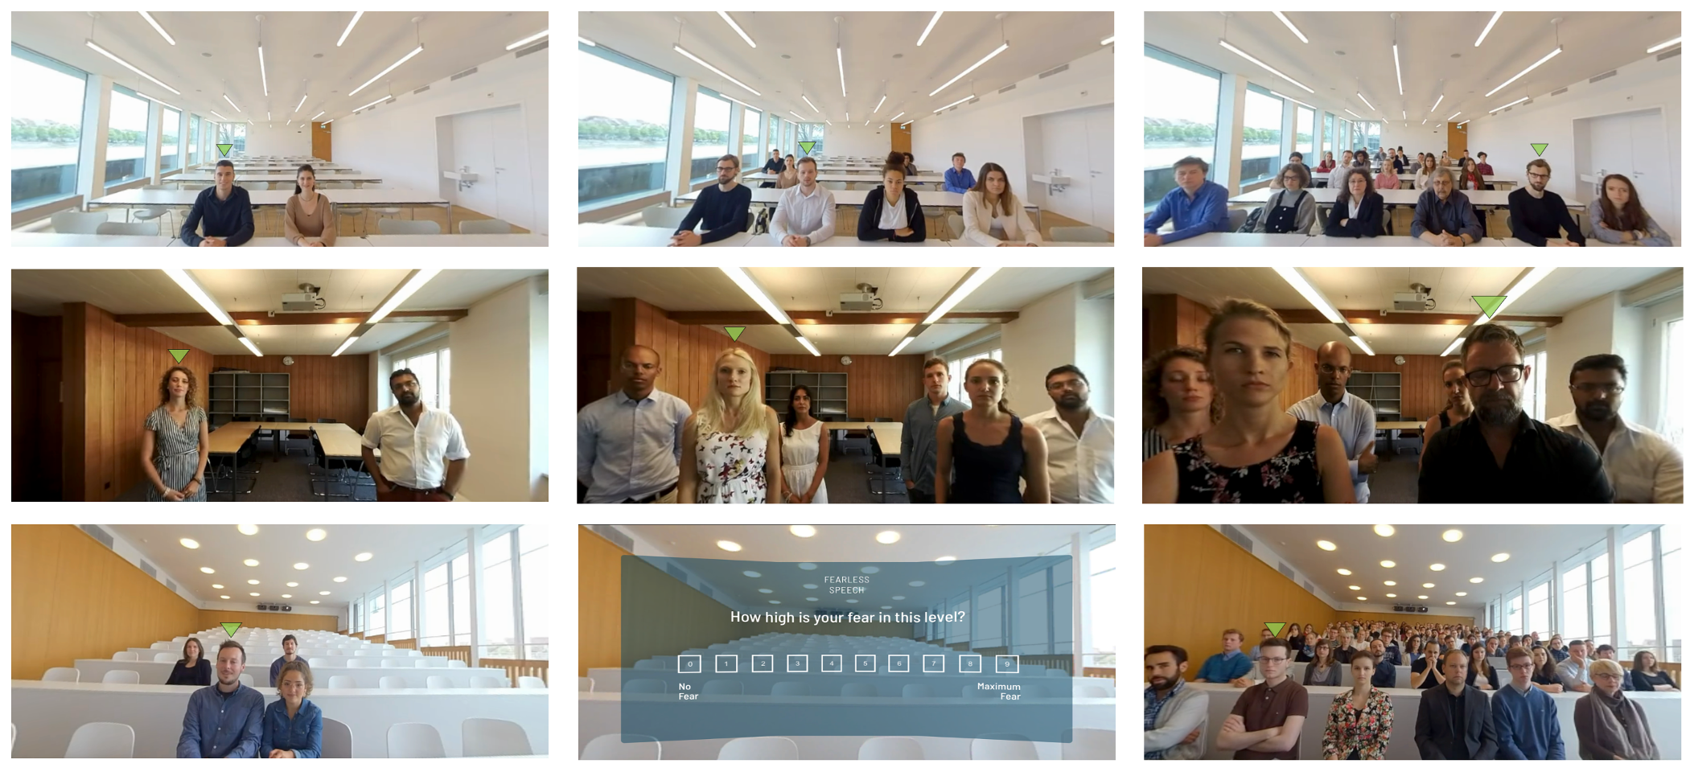
Gaze exposure treatment
The gaze exposure trained the maintenance of eye contact with audiences across progressively challenging social scenarios.
Fig.1: VR Gaze Exposure Treatment.
The figure displays a classroom (A), proximity (B), and
lecture hall scenario (C) used in the gaze exposure treatment. From left to right, the social scenario increases in difficulty, with differences in audience size, proximity, and facial expressions. A green arrow indicates a target person for maintaining eye contact.
After successfully holding eye contact with the target person over a predefined time as measured by gaze tracking, the arrow switched to the next target person to prompt a change of eye contact. Each level was repeated until the overall eye contact maintenance exceeded a predefined time threshold ranging from 56 to 96 seconds, depending on the level, and the user indicated low anxiety (i.e., < 3) on a state anxiety rating.

Slide 4
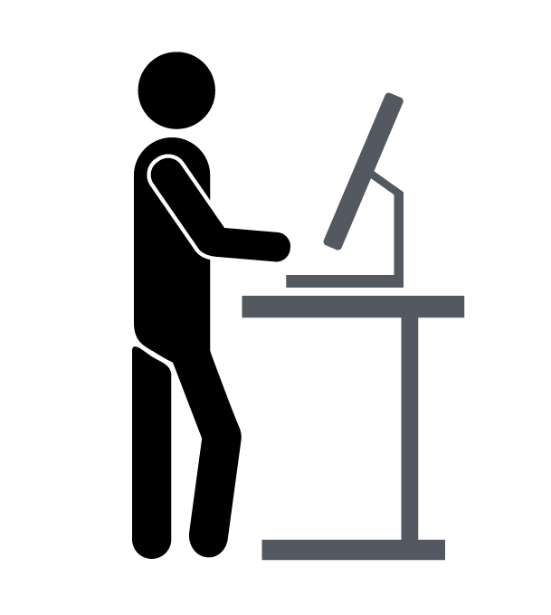
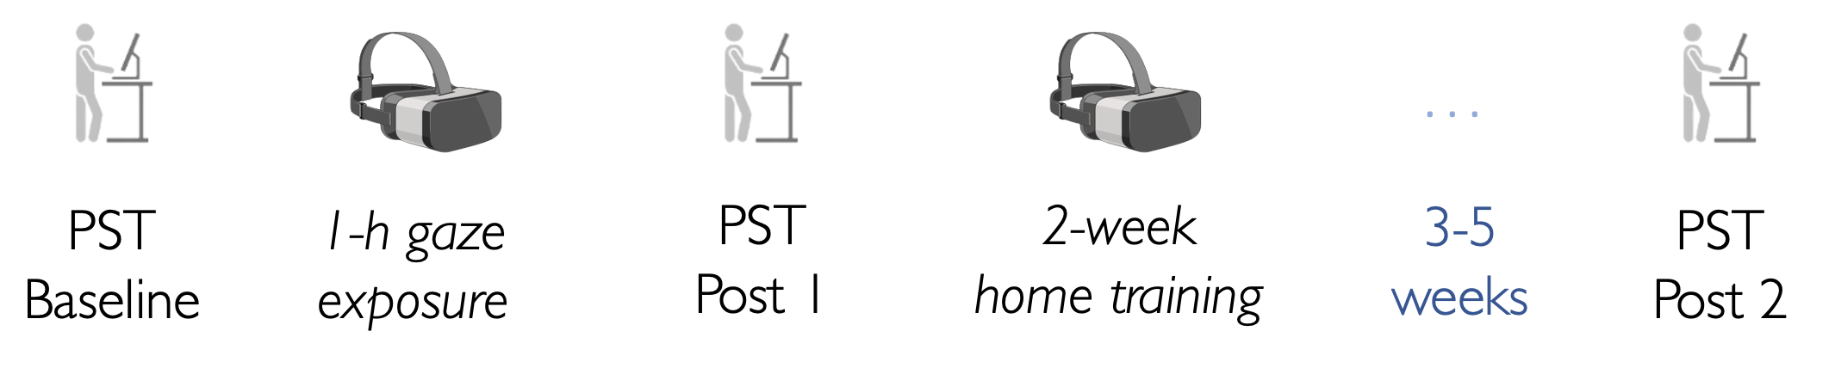
Study Design
In a single-blind, randomized controlled trial, we evaluated the effectiveness of exposure to gaze in reducing state anxiety.
89 adult participants with subclinical PSA were assigned to either a gaze exposure treatment or a control group.
PST
Baseline
1-h
gaze exposure
PST
Post 1
2-week
home training
3 – 5
weeks
PST
Post 2
Fig.2: Study Design (Treatment Condition). Assessments occurred at baseline, following a one-hour acute intervention.
(Post 1), and three to five weeks after a two-weeks home treatment (Post 2). At each assessment, participants conducted a public speaking test (PST, Fig. 3). After a baseline PST, the participants of the treatment group underwent the gaze exposure treatment in VR for 3 × 20 min, while the participants of the control group explored virtual scenarios without social content.
The second PST followed the procedure as the first one. Subsequently, the treatment group completed 9 × 20 min home treatment sessions with the gaze exposure app, while the control group did not receive any task. Three to five weeks after treatment completion of the treatment group, a third public speaking test was conducted.

Slide 5
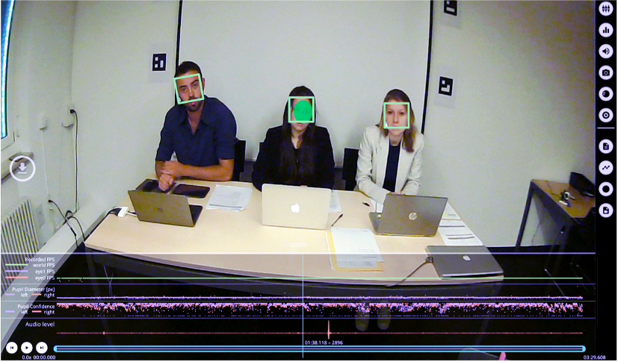
Public speaking test
We tested treatment effects in a real-life public speaking situation.
Primary Outcome: state anxiety during public speaking, assessed using the Subjective Units of Distress Scale.
Secondary Outcome: gaze avoidance during public speaking, measured by eye-tracking.
Fig.3: Participants’ view during the Public Speaking Test.
The public speaking test (PST) comprised ten minutes of semi-improvised speeches
in front of an evaluation committee. Before the first and after every speech, participants indicated their state anxiety level on the Subjective Units of Distress Scale. During the speeches, we used eye tracking and a face detection algorithm to quantify gaze avoidance as the relative dwell time off faces of any committee members during public speaking. Here, A video frame is shown, recorded from the world camera of a mobile eye tracking system, representing a participant’s perspective during the public speaking test.

Slide 6
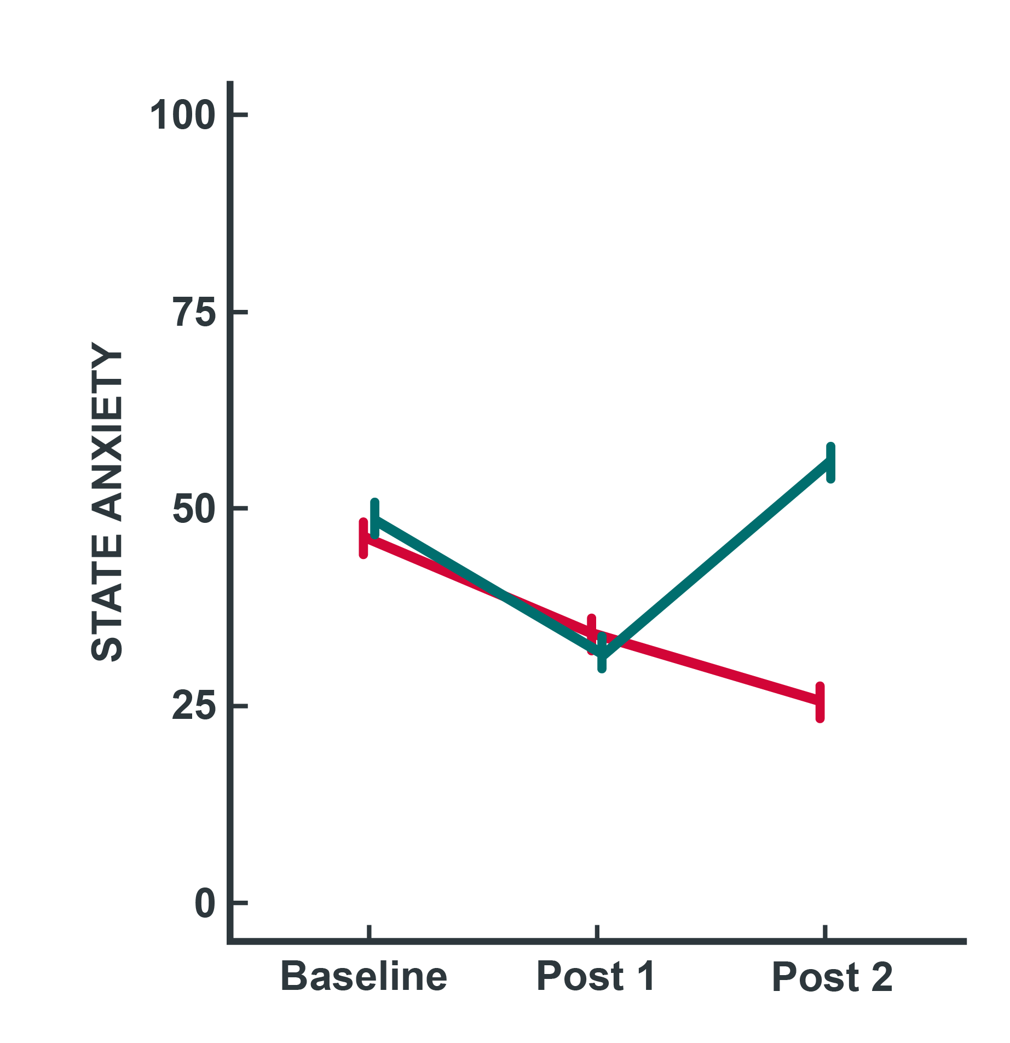
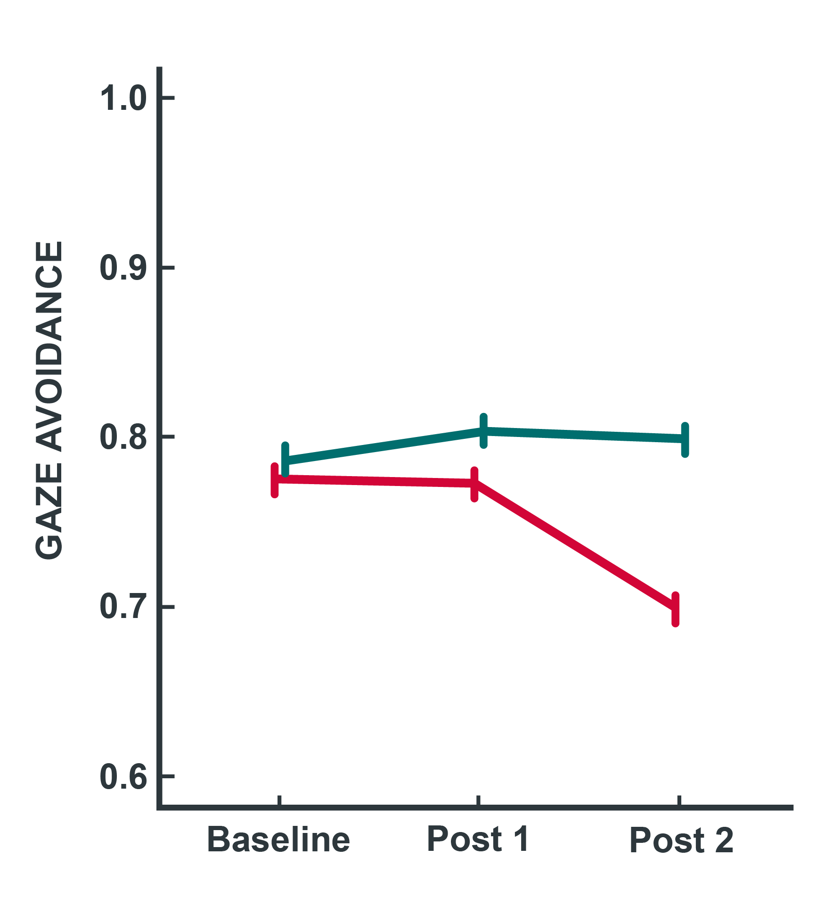
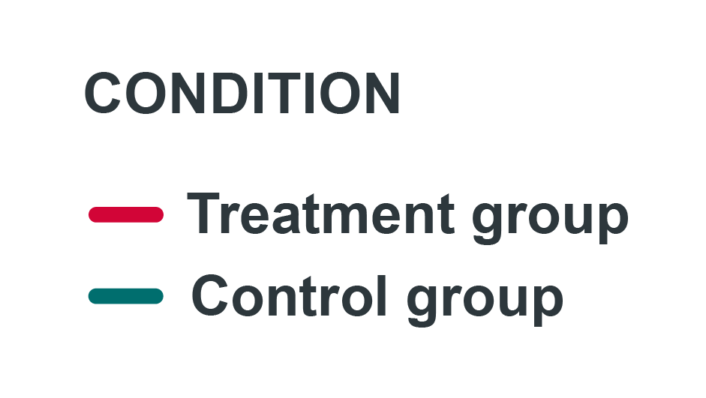
Results
Fig.4: Effects of the gaze exposure treatment on state anxiety and gaze avoidance during public speaking.
Linear mixed models' analyses suggested no reduction regarding state anxiety or the relative dwell time off faces during the public speaking test in the treatment group immediately after
1-h gaze exposure (Post 1) compared to the control group. However, there was a beneficial effect on state anxiety (cohens d' = 1.07) and gaze avoidance (cohens
d’ = - 0.97) after additional home treatment (9×20 min), as evident by the difference between the groups one month after the intervention (Post 2).

Slide 7
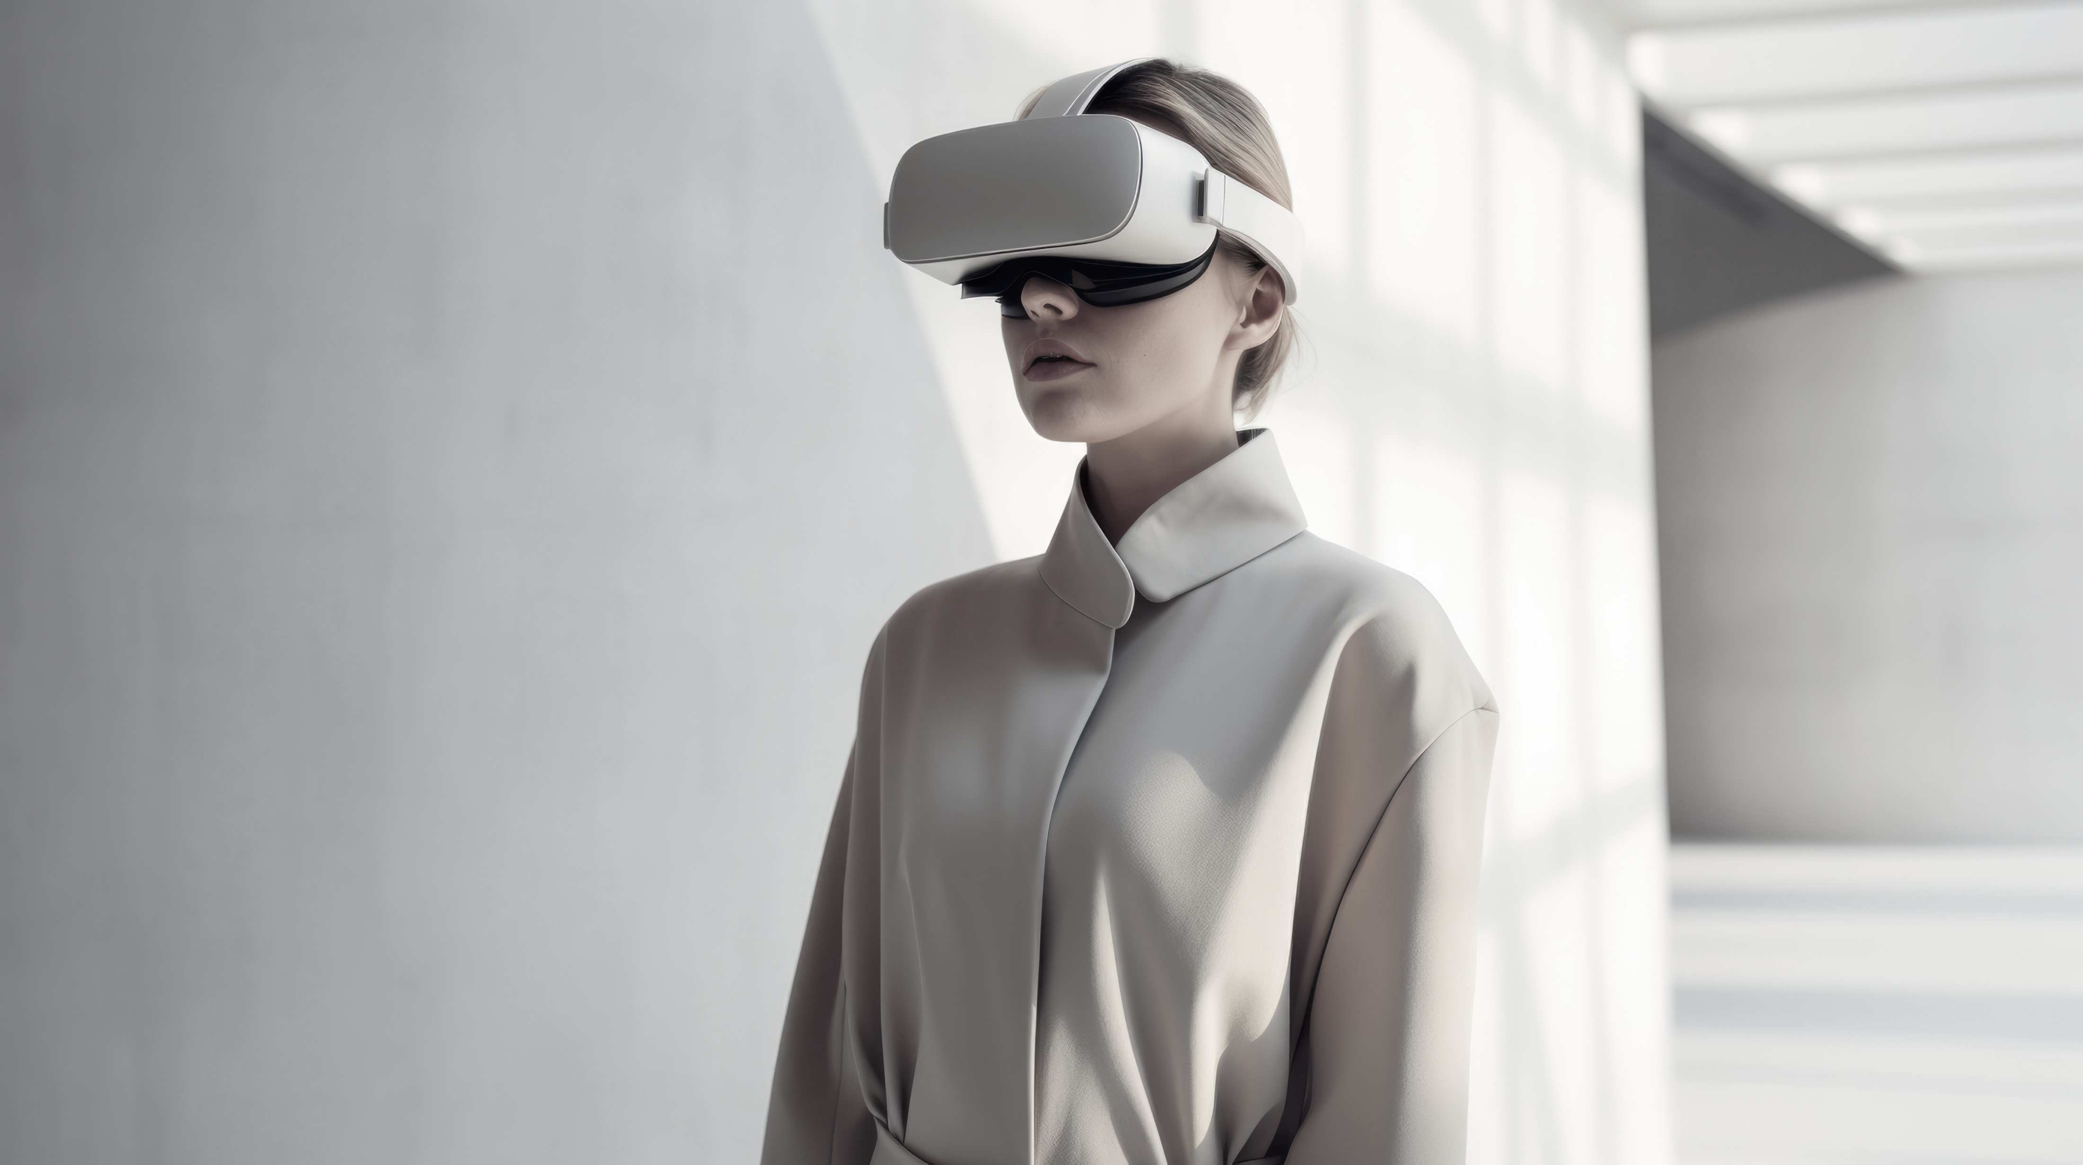
Implications
A two-week VR gaze exposure reduces state anxiety during public speaking.
VR gaze exposure requires no exposure to real people or any verbal interaction.
VR exposure apps offer accessible self-help tools at a low initiation threshold.
Image: Adobe stock

Slide 8
References / Correspondence
Faravelli, C., Zucchi, T., Viviani, B., Salmoria, R., Perone, A.,
Paionni, A., Scarpato, A., Vigliaturo, D., Rosi, S., D'adamo, D., Bartolozzi, D., Cecchi, C., & Abrardi, L. (2000).
Epidemiology of social phobia: a clinical approach.
European psychiatry: Journal of the Association of European Psychiatrists, 15(1), 17–24.
Stein, M. B., & Stein, D. J. (2008). Social anxiety disorder.
Lancet (London, England), 371(9618), 1115–1125.
Schulze, L., Renneberg, B., & Lobmaier, J. S. (2013).
Gaze perception in social anxiety and social anxiety disorder.
Frontiers in human neuroscience, 7, 872.
fabi.mueller@unibas.ch Fabian D. Mueller https://orcid.org/0000-0002-0105-700

